Slide 1

NFT price prediction using Discord community sentiment
MSc Project – University of Birmingham Varun Krishna Bhaskaran

Slide 2
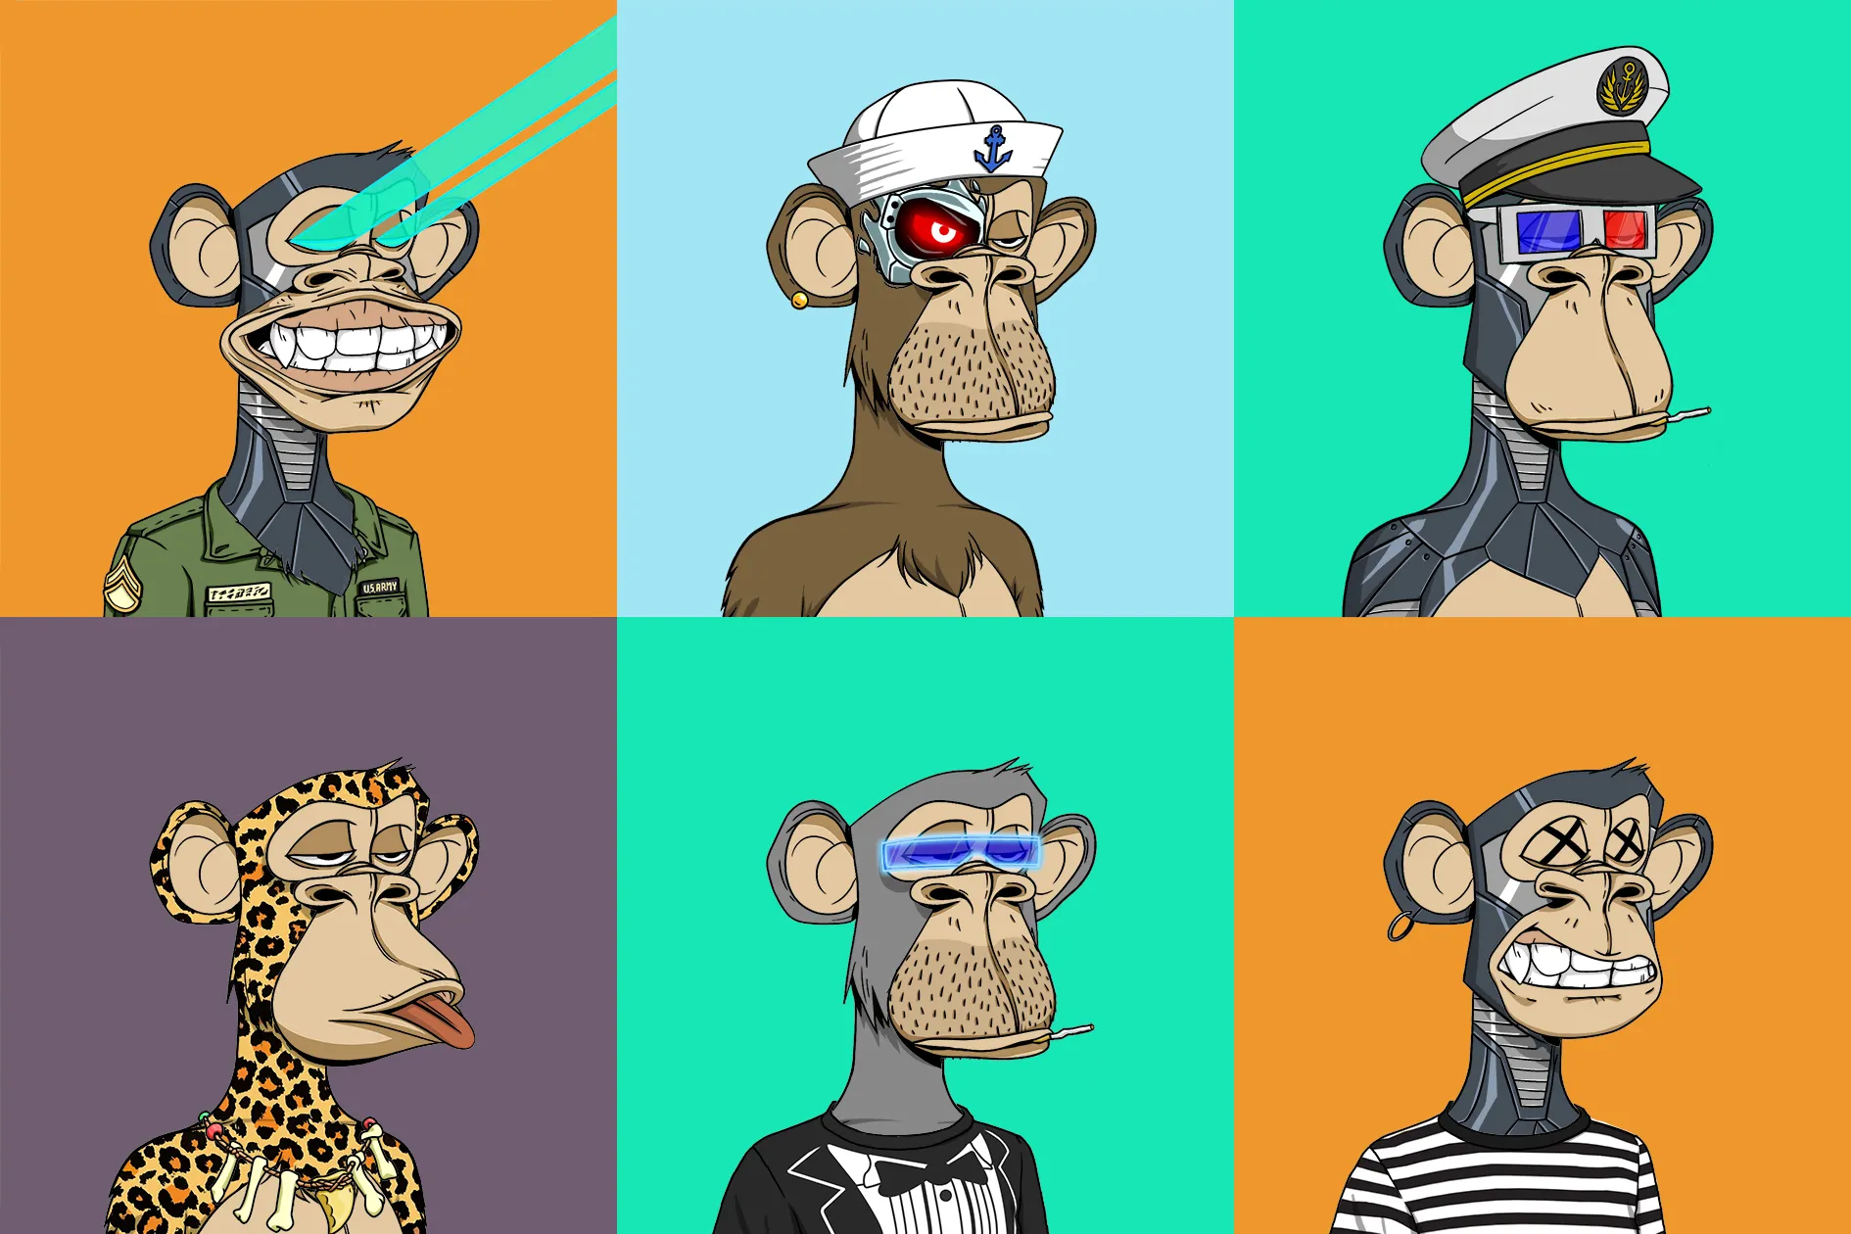
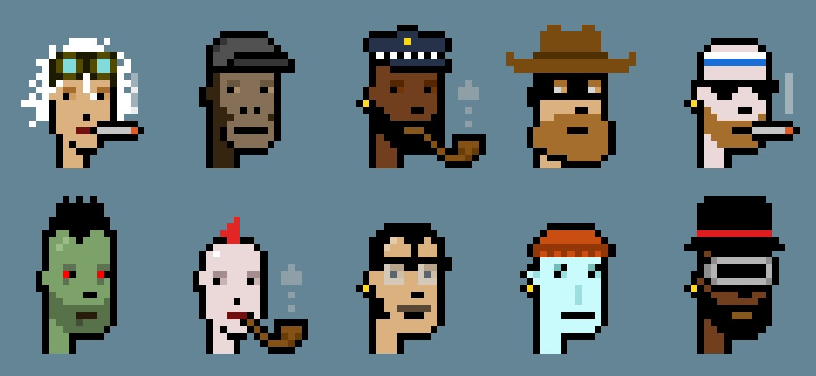
What is an NFT ?
A non-fungible token is a financial security consisting of digital data stored in a blockchain, a form of distributed ledger. The ownership of an NFT is recorded in the blockchain, and can be transferred by the owner, allowing NFTs to be sold and traded

Slide 3
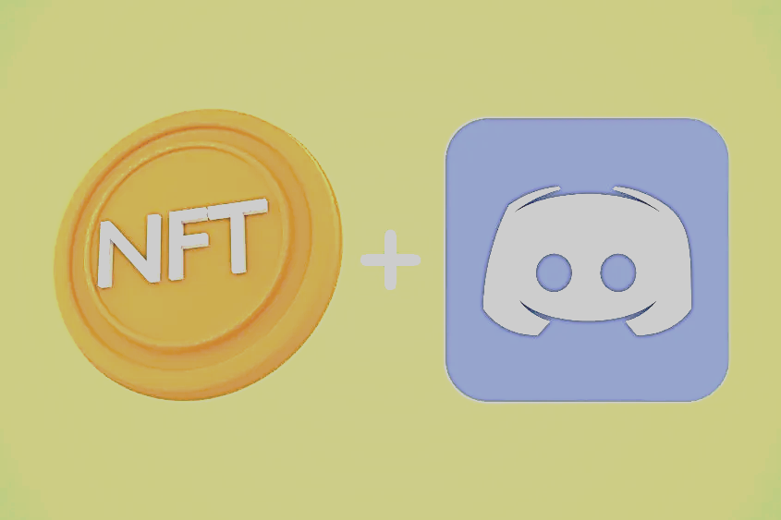
NFTs and Discord
NFT projects use Discord to build their community. In Discord groups, they can give their announcement, updates, help, and supports around the NFT Projects.
Most NFT Project are community based.
These servers are generally free to join and even encouraged by the project and community members.

Slide 4
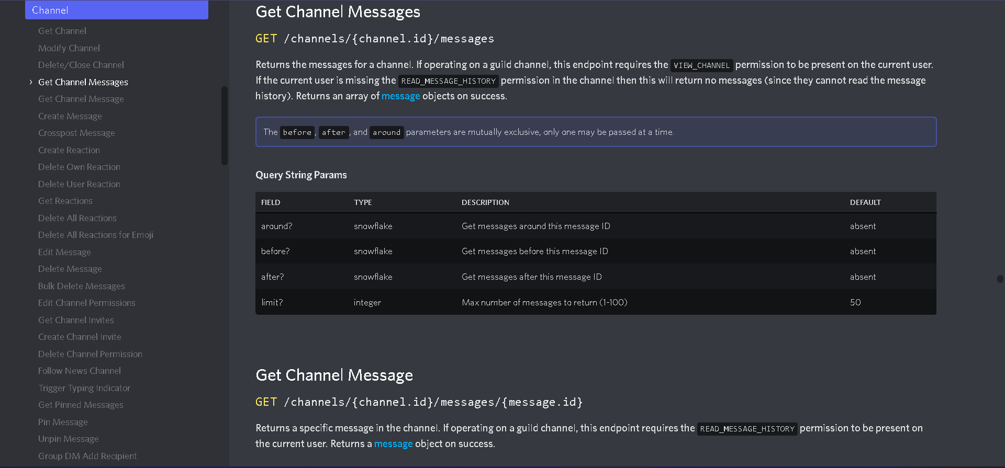
https://discord.com/developers/docs/reference

